Slide 1

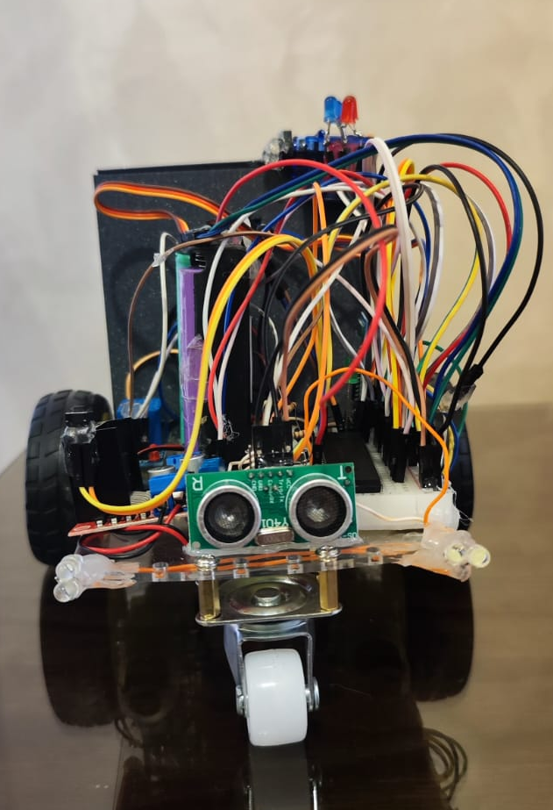
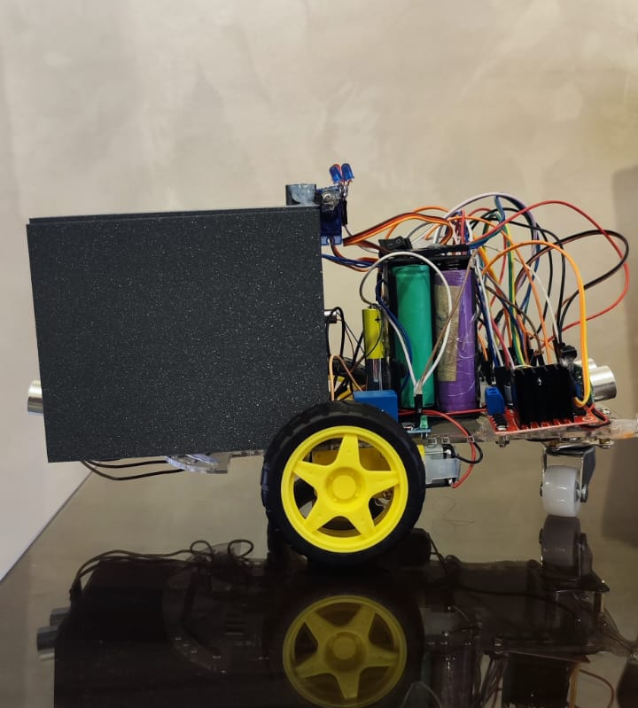
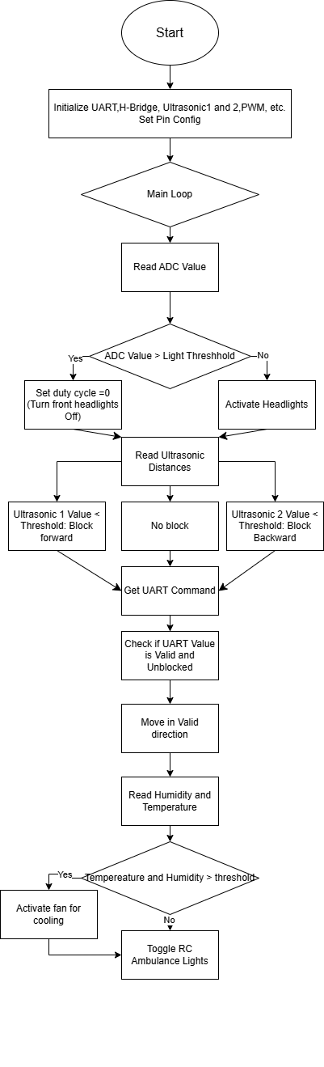
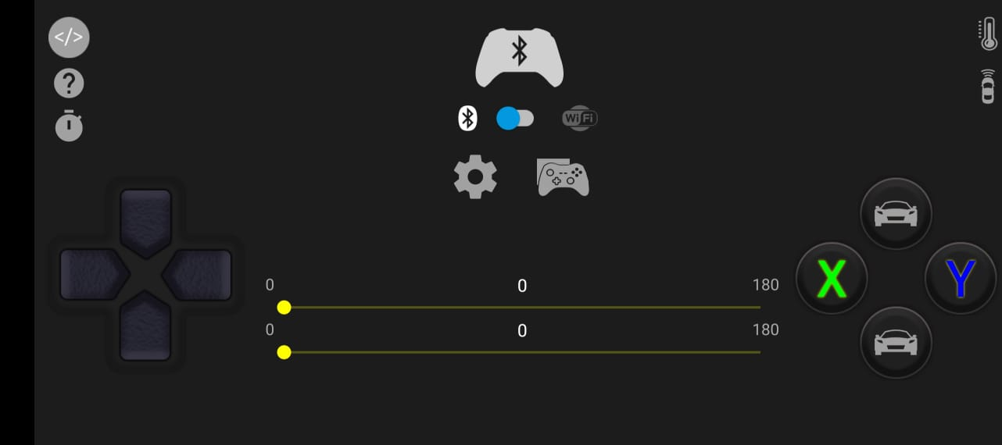
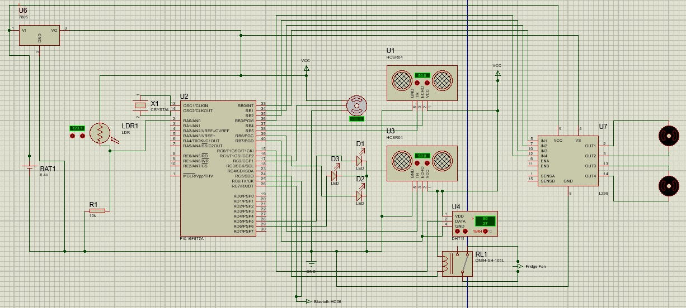
RC Medical Assistance Car
M. Marwan, M. Zeidan, and O. Alakash, Supervisor: Dr. Belal Sababha
Embedded Systems Final Design Project, Fall 2024
King Abdullah II School of Engineering
Princess Sumaya University for Technology
Introduction
The Autonomous RC Medical Assistance Car addresses challenges in providing medical aid in hazardous or inaccessible environments. It combines advanced embedded systems with features like autonomous navigation, environmental monitoring, and Bluetooth-based control. Key components include ultrasonic sensors for obstacle detection, a medical fridge for preserving supplies, and adaptive lighting using an LDR with PWM. By replacing traditional control methods with smartphone-enabled Bluetooth control, the system offers a scalable, efficient, and practical solution for emergency medical responses.
Results
After successfully programming and building the RC ambulance according to the aforementioned schematic, we achieved the following results :
Figure 3 shows the implementation of easy access on and off switch and a needed reset button for in the occasion which the RC car needed a restart. It also highlights the large capacity rechargeable batteries that power the vehicle reliably and efficiently.
Design
This design is based on a PIC 16F877A microcontroller interfaced with Bluetooth and an app on mobile devices for ease of access, LDR, and ultrasonic sensors. Lastly two motors for movement and a servo motor for quickly opening the box.
Figure 3:RC Car Design.
Car movement controls
Box open and close control
Figure 4: RC Bluetooth Controls
Figure 1: Software Design
Conclusion
The Autonomous RC Medical Assistance Car combines advanced embedded technologies to address medical emergencies in challenging environments. With features like autonomous navigation, real-time environmental monitoring, and Bluetooth-based control, the system ensures efficient delivery of critical medical supplies. A temperature-regulated fridge preserves sensitive items such as vaccines and medications, while ultrasonic sensors and adaptive lighting enhance safety and performance. Scalable and versatile, this car is adaptable to various emergency scenarios, offering a cost-effective and reliable solution for improving medical response in time-critical situations.
Figure 2: Schematic

